Slide 1

Flight Price Prediction Project submitted by: anshul dubey

Slide 2
INTRODUCTION
BUSINESS PROBLEM FRAMING
The airline industry is considered as one of the most sophisticated industry in using complex pricing strategies. Nowadays, ticket prices can vary dynamically and significantly for the same flight, even for nearby seats. Anyone who has booked a flight ticket knows how unexpectedly the prices vary. The cheapest available ticket on a given flight gets more and less expensive over time. This usually happens as an attempt to maximize revenue based on
1. Time of purchase patterns (making sure last-minute purchases are expensive)
2. Keeping the flight as full as they want it (raising prices on a flight which is filling up in order to reduce sales and hold back inventory for those expensive last-minute expensive purchases)

Slide 3
PHASES OF THE GIVEN PROJECT
This project is done in three parts:
- Data Collection
- Data Analysis
- Model Building
I created two different Jupyter Notebook files to performed the required actions.
As per the requirement of client, I have scrapped the data from online sites and based on that data I have performed analysis of data, So that one can understand
effect on flight prices with respect to other independent features.

Slide 4
MOTIVATION OF THE PROBLEM UNDERTAKEN
My main objective of doing this project is to build a model to predict the flight prices with the help of other supporting features. I am going to predict by using Machine Learning algorithms.
The sample data is collected by me from online travel sites. In order to improve the selection of flights, the client wants some predictions that could help customer in saving by taking the least risk.
There has been a considerably large number of papers adopting traditional machine learning approaches to predict flight prices accurately, but they rarely concern themselves with the performance of individual models and neglect the less popular yet complex models.

Slide 5
ANALYTICAL PROBLEM FRAMING
I am building a model in Machine Learning to predict the actual value of the prospective flight fares and decide whether to buy that ticket or not. So, this model will help us to determine which variables are important to predict the price of variables & also how do these variables describe the price of the flight ticket. This will help to determine the price of flight tickets with the available independent variables.
Regression analysis is a set of statistical processes for estimating the relationships between a dependent variable (often called the 'outcome variable') and one or more independent variables (often called 'predictors', 'covariates', or 'features'). The most common form of regression analysis is linear regression, in which one finds the line (or a more complex linear combination) that most closely fits the data according to a specific mathematical criterion. For specific mathematical reasons this allows the researcher to estimate the conditional expectation of the dependent variable when the independent variables take on a given set of values.
Regression analysis is also a form of predictive modelling technique which investigates the relationship between a dependent (target) and independent variable (predictor). This technique is used for forecasting, time series modelling and finding the causal effect relationship between the variables.

Slide 6
The different Mathematical/Analytical models that are used in this project are as below:
Linear Regression, Lasso, Ridge, SupportVectorRegressor, KNeighborsRegressor, Decision Tree Regressor, Random
Forest Regressor, Adaboost Regressor, GradientBoostingRegressor.
I have used the collected dataset and do the EDA process, fitting the best model and saving the model.

Slide 7
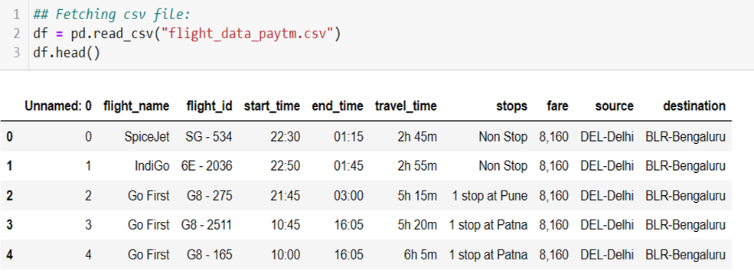
DATA SOURCES AND THEIR FORMATS:- I have scrapped data from Paytm travel website and then saved that data into flight_data_paytm csv file.

Slide 8
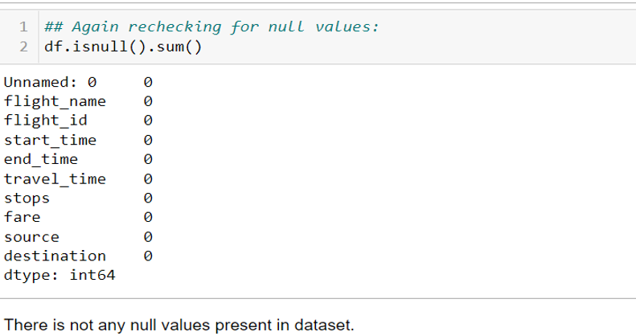
CHECKING THE NUMBER OF NULL VALUES IN THE DATASET

Slide 9
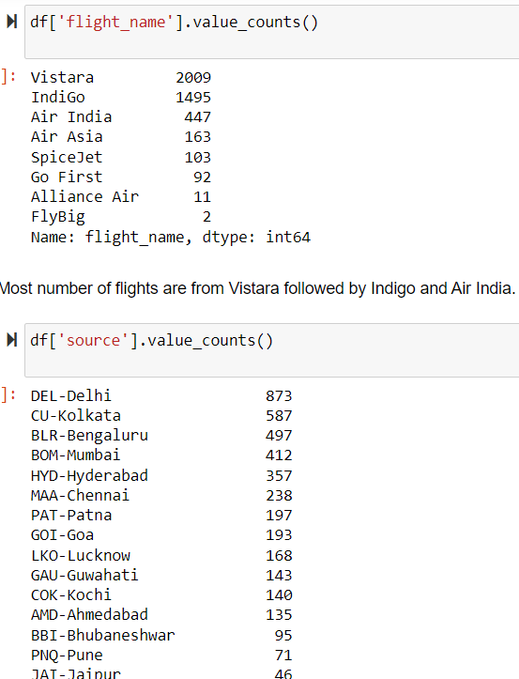
DATA PREPROCESSING

Slide 10
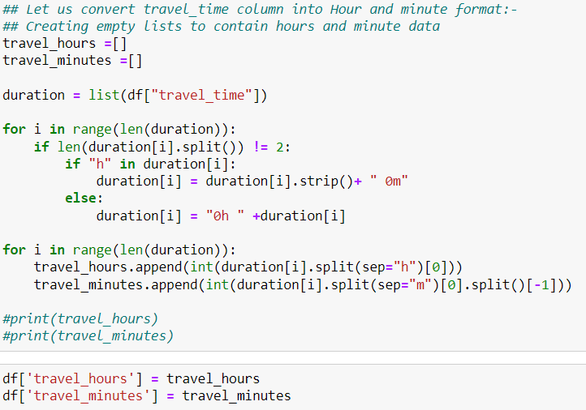
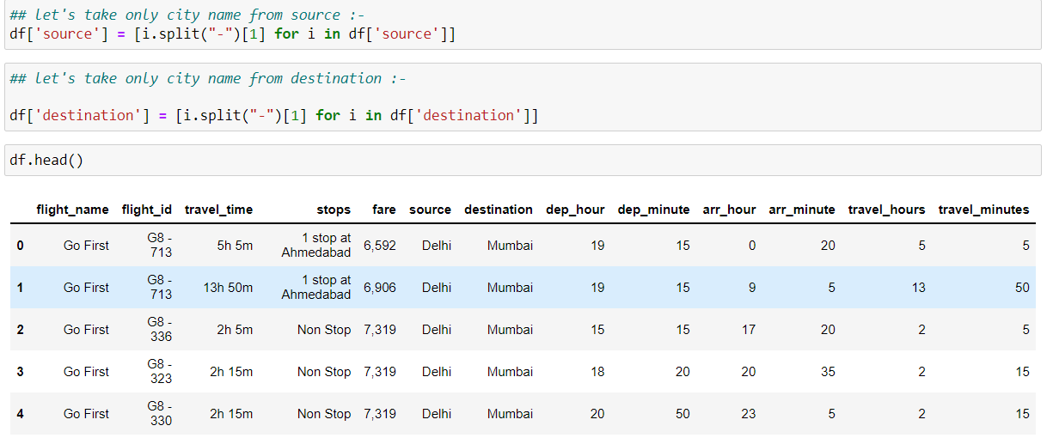
Putting Data in Proper Format

Slide 11
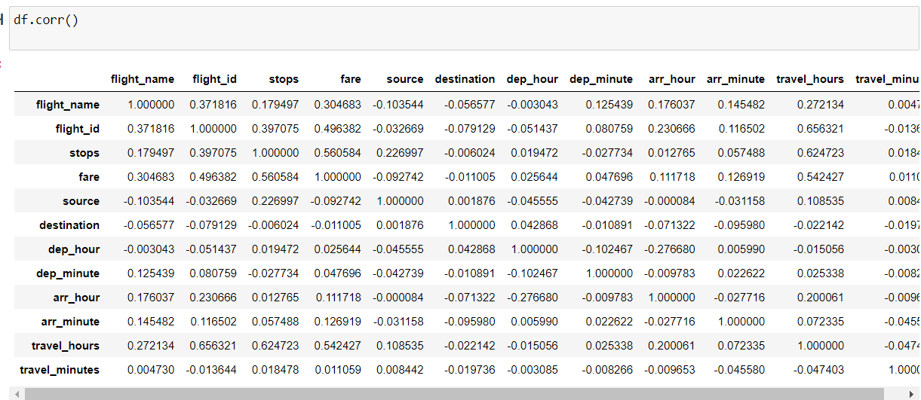
CORRELATION FACTOR
The statistical relationship between two variables is referred to as their correlation. The correlation factor represents the relation between columns in a given dataset. A correlation can be positive, meaning both variables are moving in the same direction or it can be negative, meaning that when one variable's value increasing, the other variable’s value is decreasing

Slide 12
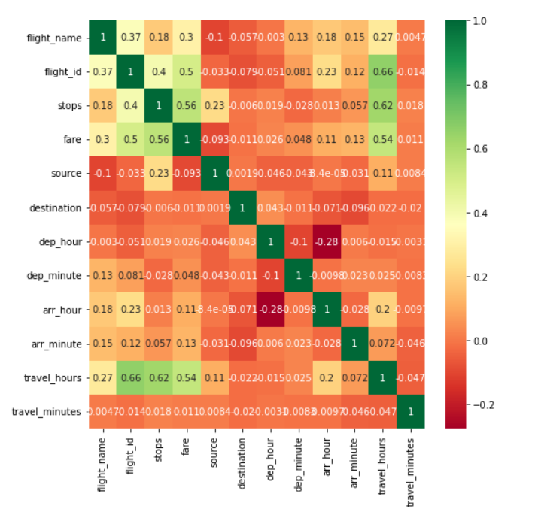
CORRELATION MATRIX AND ITS VISUALIZATION
A correlation matrix is a tabular data representing the ‘correlations’ between pairs of variables in a given dataset. It is also a very important pre-processing step in Machine Learning pipelines. The Correlation matrix is a data analysis representation that is used to summarize data to understand the relationship between various different variables of the given dataset.

Slide 13
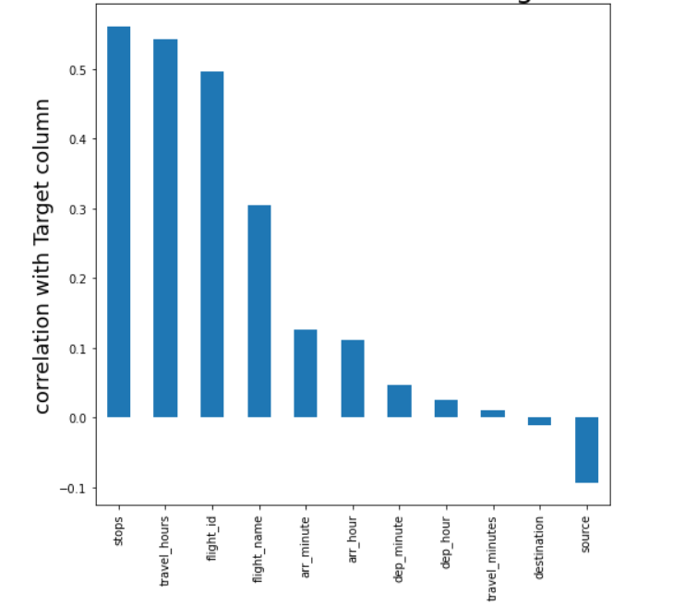
CORRELATION WITH TARGET VARIABLE
1.stops and travel_ hours ,these columns have good positive relationship with target column.
2.destination, arr_hour, and arr_minute columns have very weak relationship with target column.
3.source co;umns are negatively correlated with target column.

Slide 14
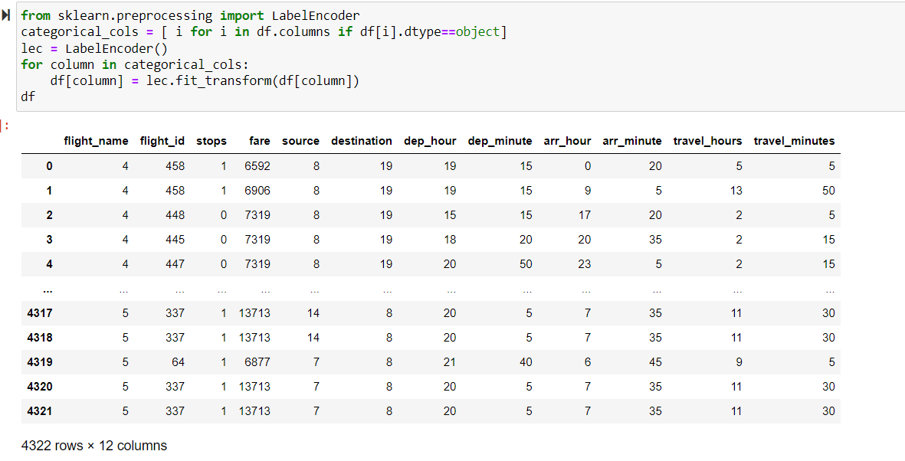
Label Encoding

Slide 15
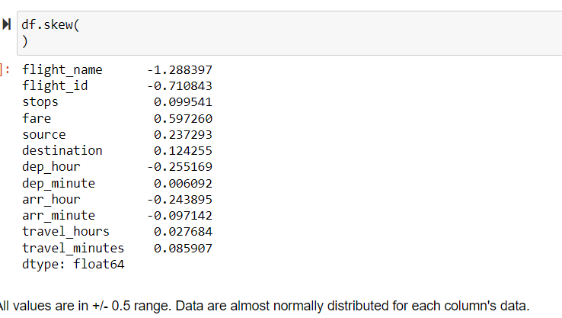
CHECKING SKEWNESS
Skewness refers to distortion or asymmetry in a symmetrical bell curve, or normal distribution in a set of data. Besides positive and negative skew, distributions can also be said to have zero or undefined skew. The skewness value can be positive, zero, negative, or undefined.

Slide 16
CHECKING OUTLIERS AND PLOTTING IT
An outlier is a data point in a data set which is distant or far from all other observations available. It is a data point which lies outside the overall distribution which is available in the dataset. In statistics, an outlier is an observation point that is distant from other observations.
A box plot is a method or a process for graphically representing groups of numerical data through their quartiles. Outliers may also be plotted as an individual point. If there is an outlier it will plotted as point in box plot but other numerical data will be grouped together and displayed as boxes in the diagram. In most cases a threshold of 3 or -3 is used i.e., if the Z-score value is higher than or less than 3 or -3 respectively, that particular data point will be identified as outlier.

Slide 17
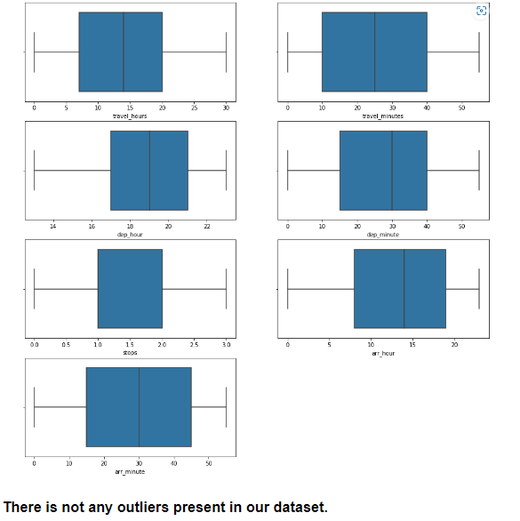
Outliers

Slide 18
MODEL/S DEVELOPMENT AND EVALUATION
From the given dataset it can be concluded that it is a Regression problem as the output column “fare” has continuous output. So, for further analysis of the problem, I have to import or call out the Regression related libraries in Python work frame.
The different libraries used for the problem solving are:
Sklearn
Sklearn.linear_model
Sklearn.ensemble
Sklearn.metrics
Sklearn.model_selection

Slide 19
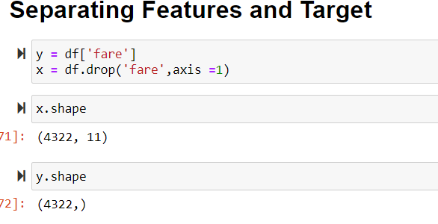
TESTING OF IDENTIFIED APPROACHES
After completing the required pre-processing techniques for the model building data is separated as input and output columns before passing it to the train_test_split.

Slide 20
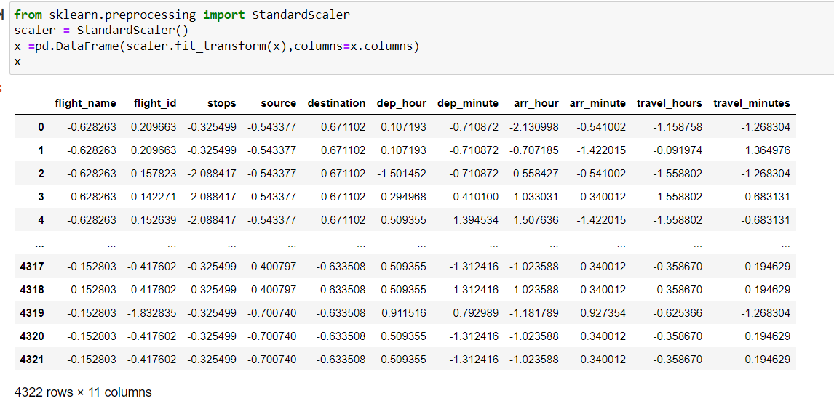
SCALING THE DATA USING STANDARD SCALER
For each value in a feature, StandardScaler subtracts the minimum value in the feature and then divides by the range. The range is the difference between the original maximum and original minimum. StandardScaler preserves the shape of the original distribution.

Slide 21
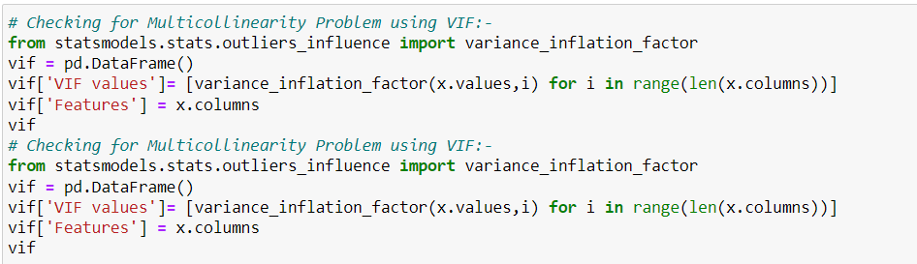
Multicollinearity check using VIF

Slide 22
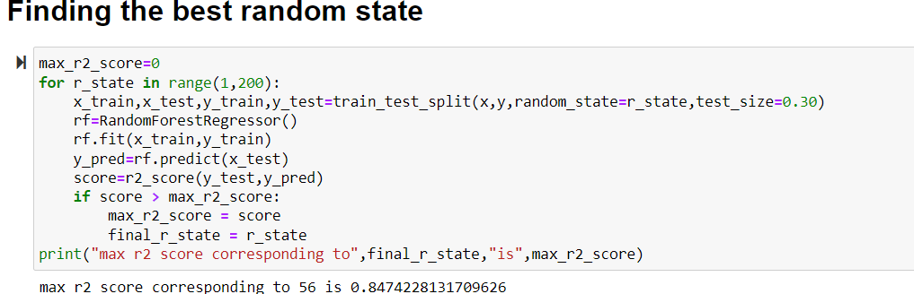
RUN AND EVALUATE SELECTED MODELS
We will find the best random state value so that we can create our train_test_split

Slide 23
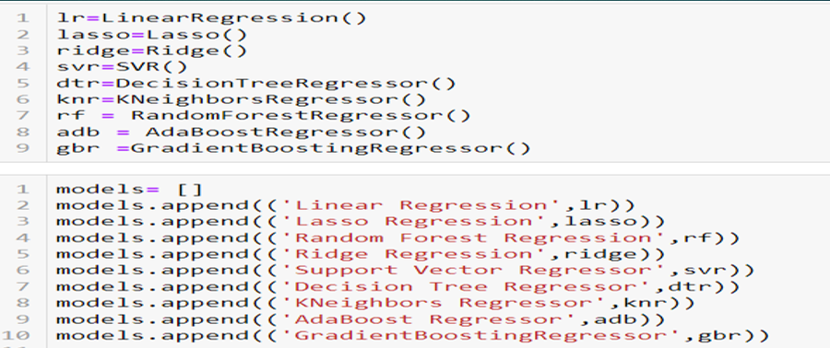
As you can see above, I had called the algorithms, then I called the empty list with the name models [ ], and calling all the model one by one and storing the result in that.
We can observe that I imported the metrics in order to interpret the model’s output. Then I also selected the model to find the cross_validation_score value.

Slide 24
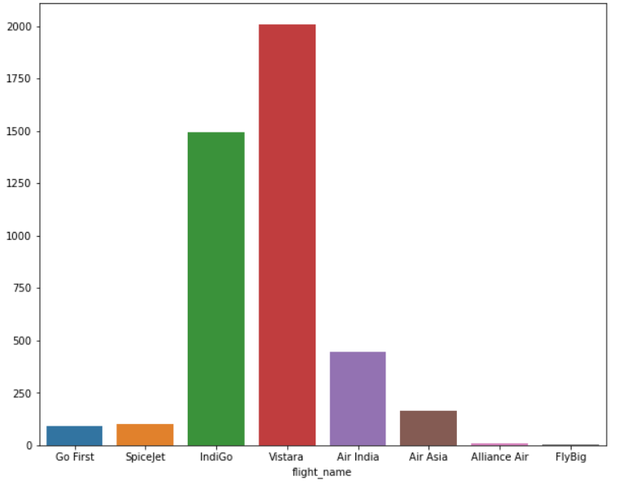
DATA VISUALIZATION
Now, we will see the different plots done with this dataset in order to know the insight of the data present. Below are the codes given for the plots and the output obtained:

Slide 25
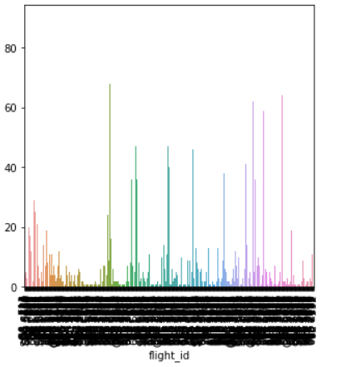
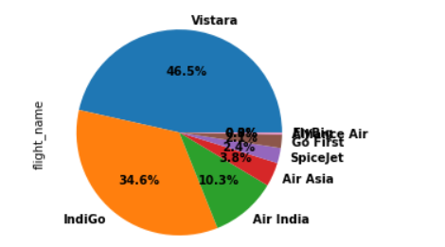
PLOTTING GRAPHS FOR CATEGORICAL DATA

Slide 26
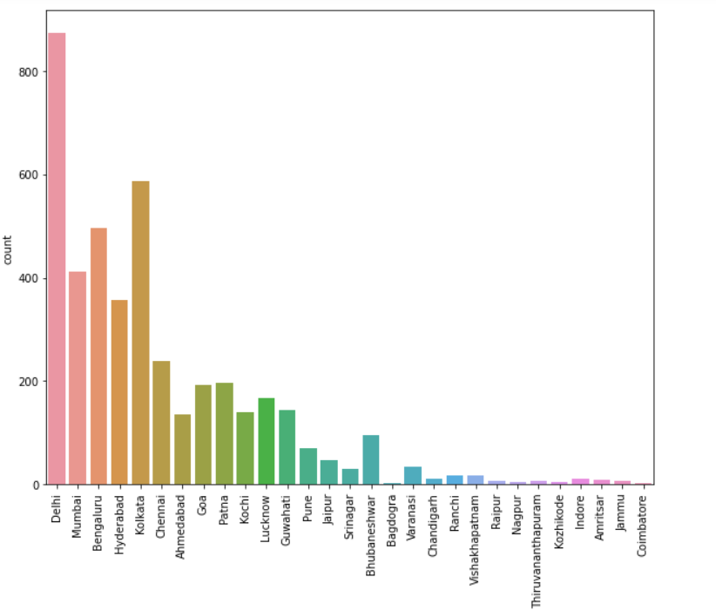
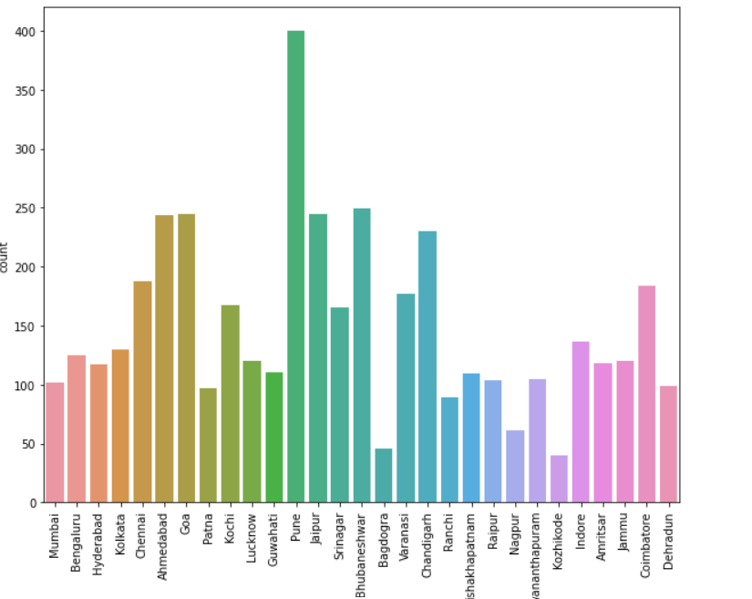
Visulization

Slide 27
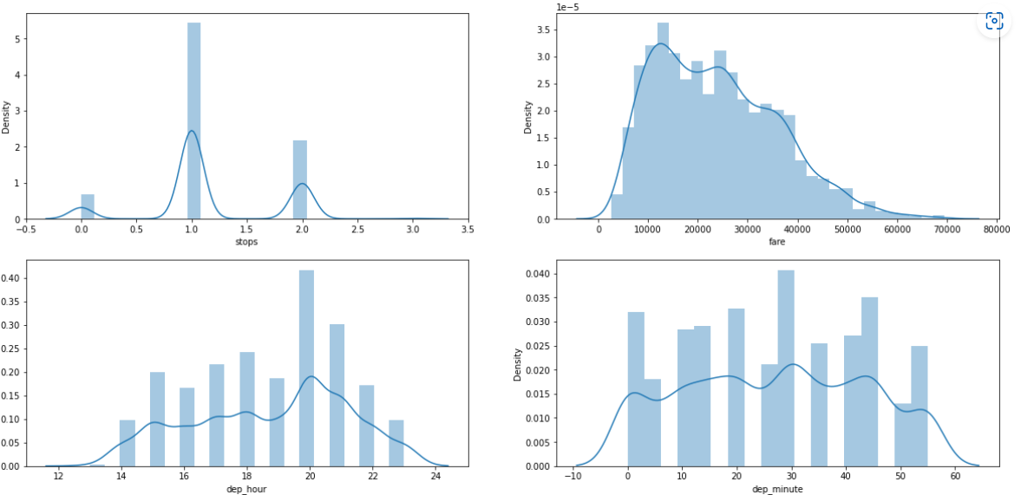
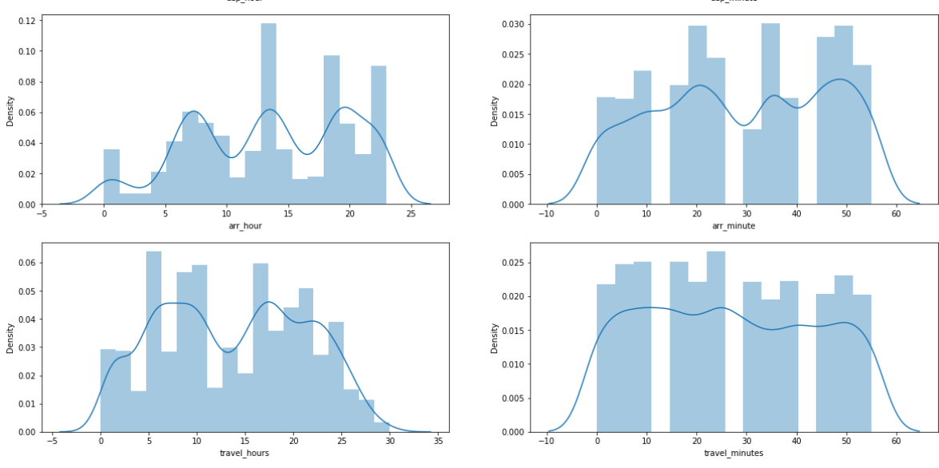
TAKING ALL CONTINUOUS DATA AND PLOTTING HISTOGRAM

Slide 28
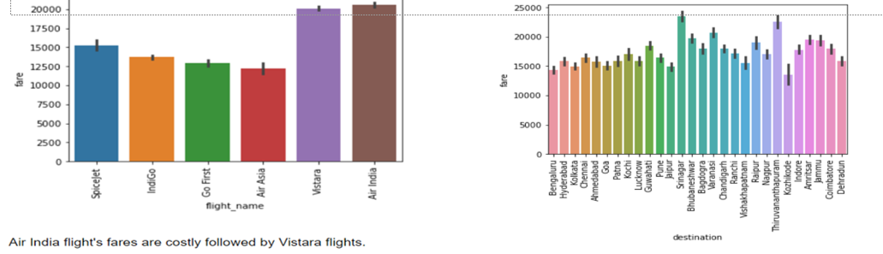
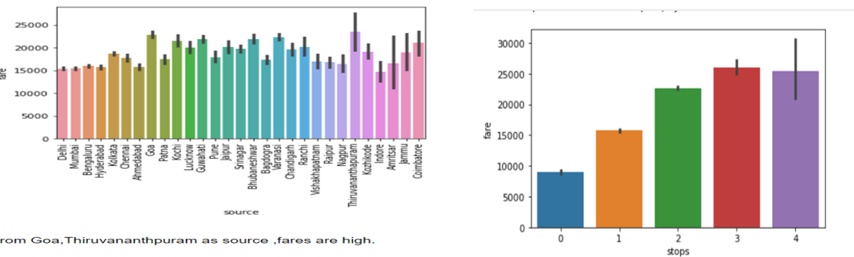
BIVARIATE ANALYSIS WITH Prices FOR CATEGORICAL DATA

Slide 29
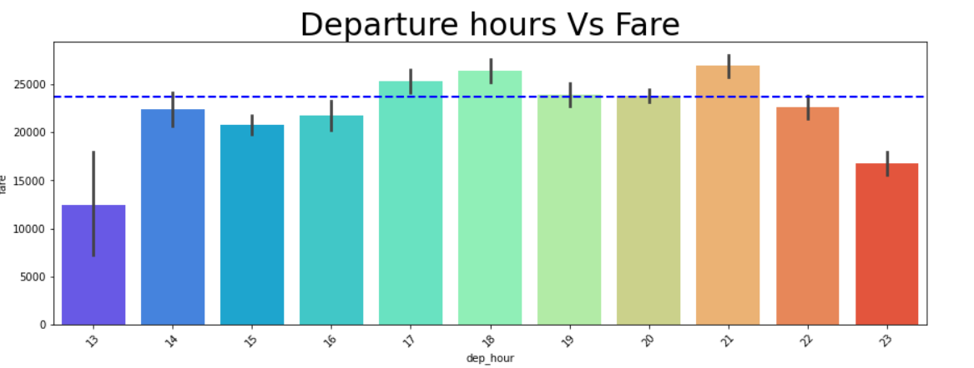
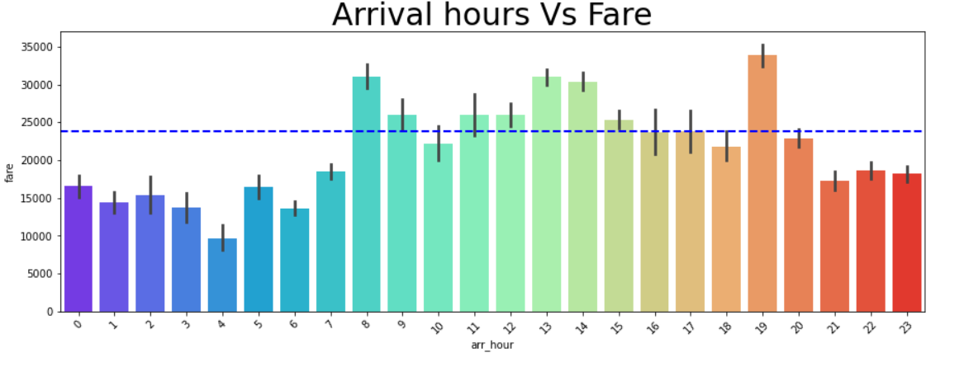
PLOTTING FOR CONTINUOUS DATA

Slide 30
CONCLUSION
Most No of Flights are available from Mumbai. and pune.
Among Vistara, Air India, Indigo, Go First, Air Asia, SpiceJet flights, Air India flights are most expensive followed by Vistara flights.
Non Stop Flights are cheaper than flights including stops.
As Travel Hour increases, Fare Increases.
Vistara flights availability is more than any other airlines for different places.
Evening flights availability is more than morning flights.
Early morning and late nights flights are cheaper.

Slide 31
Thankyou

